Slide 1

INSTRUCTIONS

Slide 2
UNSAFE AI DECISIONS
Filip Cano
Institute of Science and Technology Austria
Lab organisers, please note:
Add your Lab’s name in the bottom-left corner and insert any additional partner logos here before sending the template to presenters.
VIENNA

Slide 3
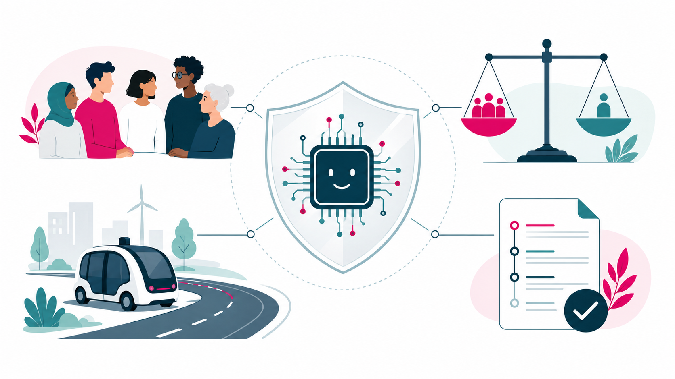
FILIP CANO
BREAKING THE WALL OF [PLEASE INSERT YOUR TOPIC HERE]
AI is moving from academic predictions to decisions that affect people.
AI can be powerful,
but also dangerous
Unsafe actions
Biased decisions
Unclear responsibility

Slide 4

FILIP CANO
BREAKING THE WALL OF [PLEASE INSERT YOUR TOPIC HERE]
A FORMAL SHIELD FOR
RESPONSIBLE AI
With a good model, we can guarantee safety and fairness —
and explain why we intervene.
AI
SAFER
ACTION
model-based runtime checks
VERIFY • EXPLAIN • NUDGE • ASK HUMAN • BLOCK
FORMAL
EXPLAINABLE
HUMAN CONTROL
GUARANTEES
Provable guarantees within the model. Clear reasons. Human oversight.

Slide 5
FILIP CANO
BREAKING THE WALL OF [PLEASE INSERT YOUR TOPIC HERE]
TEMPLATE STARTS

Slide 6
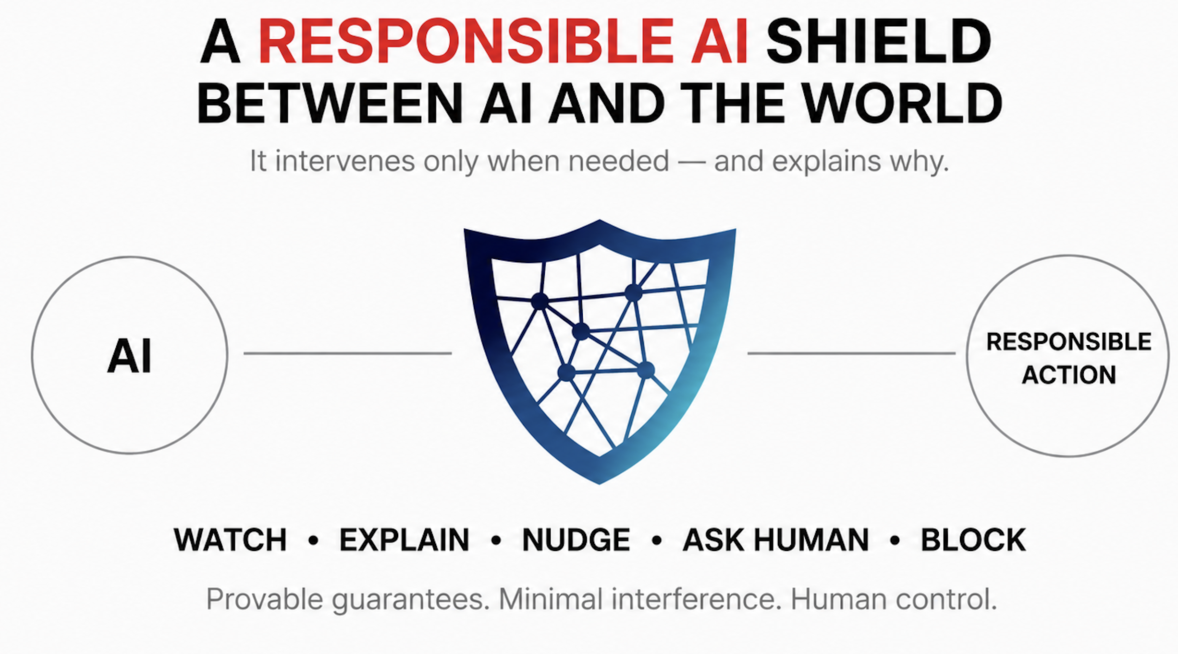
FILIP CANO
BREAKING THE WALL OF [PLEASE INSERT YOUR TOPIC HERE]

Slide 7
FILIP CANO
BREAKING THE WALL OF [PLEASE INSERT YOUR TOPIC HERE]
TEMPLATE STARTS

Slide 8
FILIP CANO
BREAKING THE WALL OF [PLEASE INSERT YOUR TOPIC HERE]
CONTENT SLIDE 1 –
EXPLAIN THE PROBLEM

Slide 9
FILIP CANO
BREAKING THE WALL OF [PLEASE INSERT YOUR TOPIC HERE]
CONTENT SLIDE 2 –
OFFER YOUR SOLUTION

