Slide 1


Explaining Decisions One Conversation at a Time: Opportunities and Risks of LLMs as
Explainability Assistants
Filip Cano
Institute of Science and Technology Austria

Slide 2
In a nutshell
Opportunities and Risks of LLMs as Explainability Assistants Filip Cano
Explainability methods are useful, but made by and for engineers
“Right of an explanation” as a foundation of trust
  But… What is an explanation? 📖
LLMs can help us bridge this gap!
📖 Tim Miller, Explanation in artificial intelligence: Insights from the social sciences. Artificial Intelligence (vol 267). 2019

Slide 3
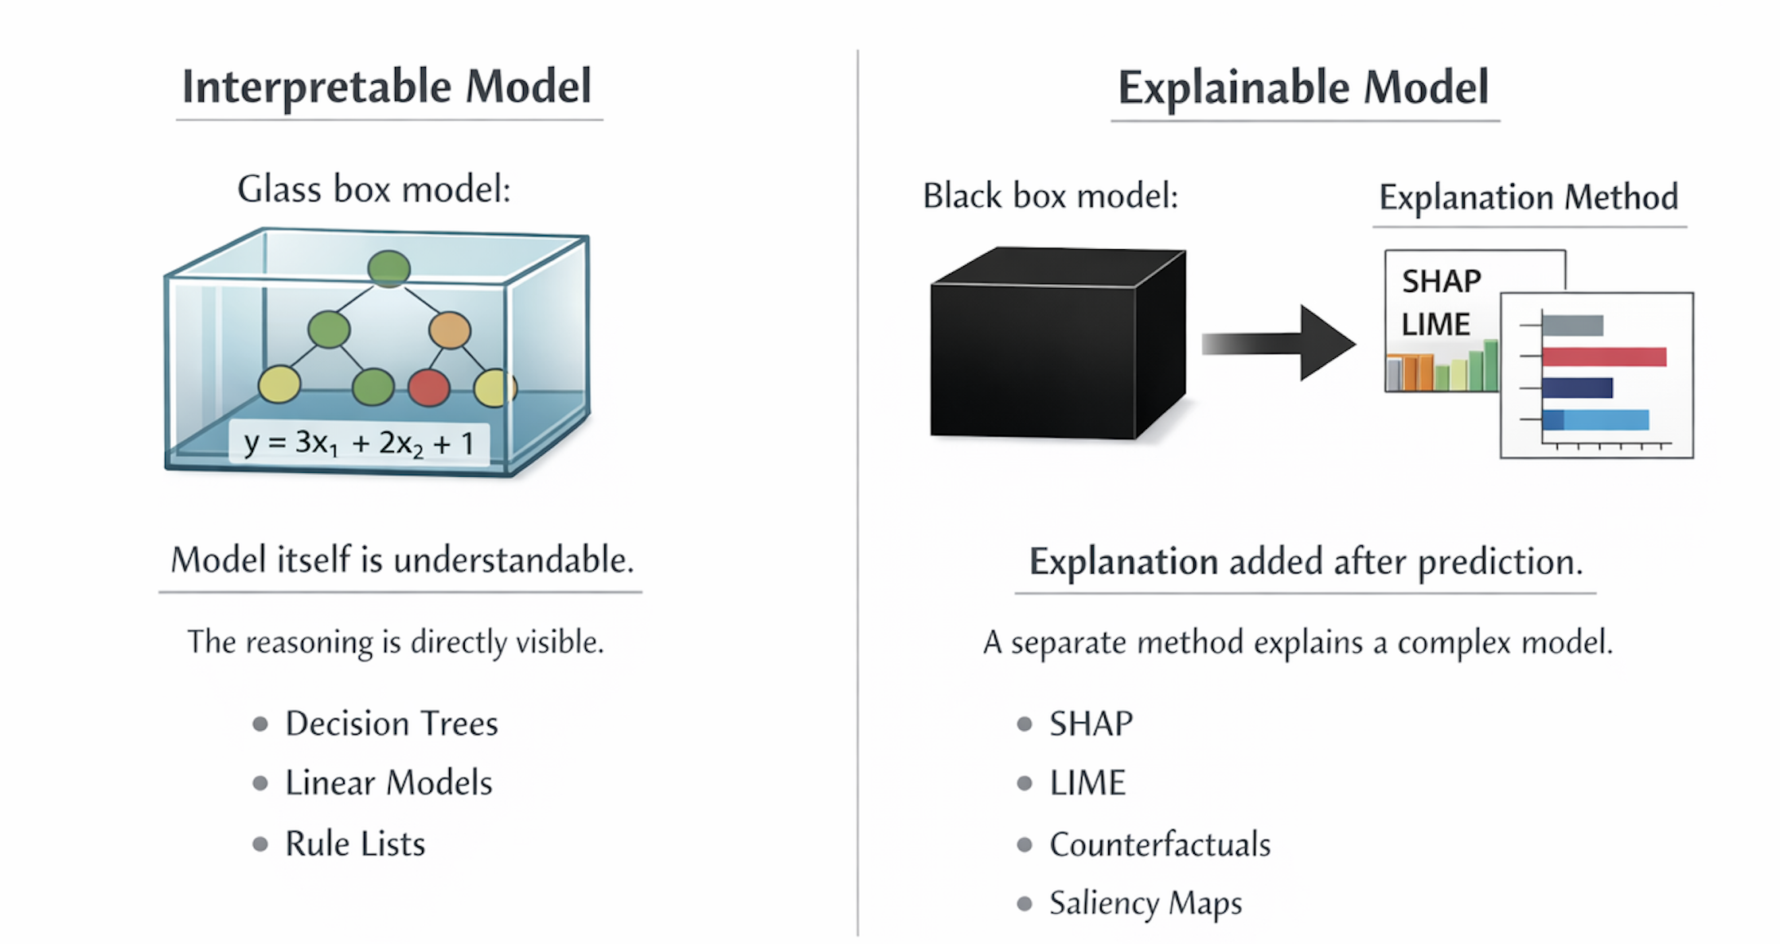
Explainable vs Interpretable AI
Opportunities and Risks of LLMs as Explainability Assistants Filip Cano
*Image generated with help of generative AI

Slide 4
Explainable vs Interpretable AI
Opportunities and Risks of LLMs as Explainability Assistants Filip Cano
Interpretable AI
Transparency by design
Examples: Decision trees, rule lists, linear models…
You can directly inspect the decision logic…. If you can understand it
Explainable AI
Post-hoc explanations of opaque methods.
Examples: SHAP, LIME, saliency maps, counterfactuals…
You can apply it to any method… if your explanation is faithful enough

Slide 5


Global vs Local Explainability
Opportunities and Risks of LLMs as Explainability Assistants Filip Cano
Much of explainable AI is based on surrogate models that are interpretable
Explanatory surrogate models can be local or global

Slide 6
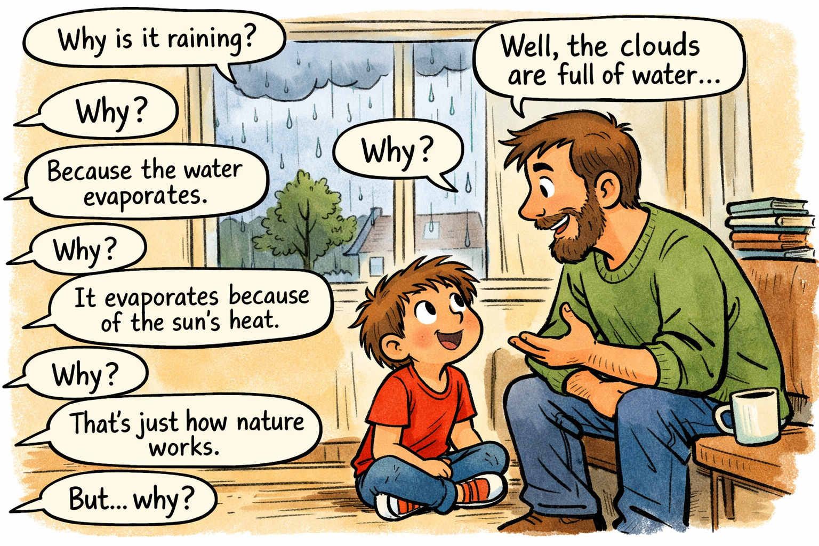
A good explanation is a conversation
Opportunities and Risks of LLMs as Explainability Assistants Filip Cano
*Image generated with help of generative AI

Slide 7
LLMs as an Interface Between Models and Users
Opportunities and Risks of LLMs as Explainability Assistants Filip Cano
Saliency / attribution
LLM assistant
User-facing explanation
Counterfactuals
Model internals / queries
• translate technical signals
• adapt to user background
• support follow-up questions

Slide 8
The Two Roles of Explanations
Opportunities and Risks of LLMs as Explainability Assistants Filip Cano
AI Engineer’s perspective
Understanding the model helps with testing, validation, and debugging
Explanation can lead to efficiency and performance improvements
User/subject’s perspective
”Right of an explanation”
Accountability and fairness concerns
What do I need to change to obtain a different decision?

Slide 9
The Danger: Explanation that Sound Just Right
Opportunities and Risks of LLMs as Explainability Assistants Filip Cano
Hallucination
Conflict avoidance
Oversimplification
Fluent but fabricated statements can be mistaken for faithful explanations.
A polite assistant may suppress ambiguity or disagreement to keep the conversation smooth.
Important interactions and edge cases can disappear inside a tidy narrative.

Slide 10
Can We Verify Explanations?
Opportunities and Risks of LLMs as Explainability Assistants Filip Cano
Anchor explanations to real model signals
Test changes before providing counterfactual explanations
Compare with database of know failures
Test faithfulness of surrogate models

Slide 11
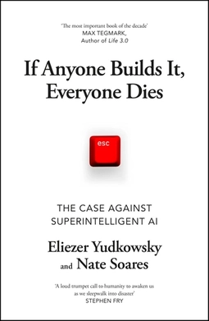
The Risk of Losing Build Public Trust
Opportunities and Risks of LLMs as Explainability Assistants Filip Cano
Public trust in technology builds slowly and is destroyed quickly
Cautionary tale: COMPAS 📖
Current perception of LLMs is mixed
  Comparison of current and future AI with nuclear weapons
📖 J. Angwin et al. Machine Bias. ProPublica. 2016

Slide 12
Main Uses of LLMs for Explanations
Opportunities and Risks of LLMs as Explainability Assistants Filip Cano
1. Assistive interpretation
2. Direct rationale generation
• summarize model behavior
• interpret saliency / attribution outputs
• translate counterfactuals into plain language
• act as a conversational layer on top of existing XAI tools
• generate justifications for their own predictions
• generate justifications for another model’s prediction
• sound coherent and contextual
• but may fail to reflect the real reasoning process

Slide 13
Some Best Practices
Opportunities and Risks of LLMs as Explainability Assistants Filip Cano
1
Ground explanations in verifiable model behavior
2
Clear communication of uncertainties and limitations
3
Adapt the explanation to the audience
4
Use multiple methods to corroborate claims
5
Keep the whole explanation pipeline transparent and auditable

Slide 14
The Road Ahead
Opportunities and Risks of LLMs as Explainability Assistants Filip Cano
Hybrid systems
Better evaluation
Societal deployment
LLMs could connect more directly to model internals so faithfulness can be checked dynamically.
Metrics based on fidelity and user impact.
Stronger ethics guardrails and failure containment. Build-up of public trust

Slide 15
Conclusion
Opportunities and Risks of LLMs as Explainability Assistants Filip Cano
LLMs can make explanations more interactive explanations for interpretable and explainable AI methods
Main risks:
  Explanations that sound right but are not grounded on real behaviour
  Once you lose public trust, it’s difficult to gain it back

